Slide 1
Flow charts and conditions

Slide 2
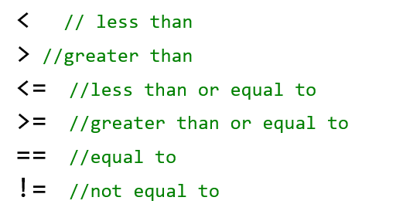
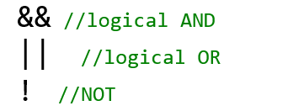

Slide 3
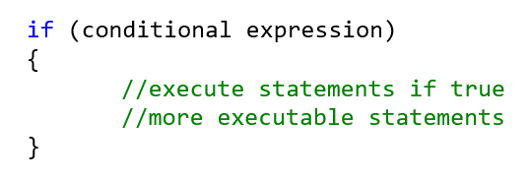
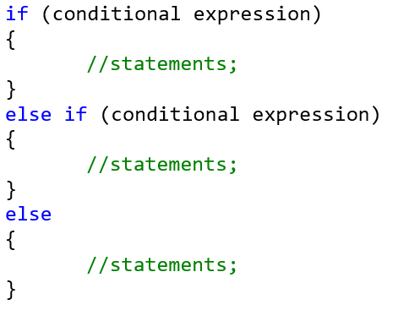
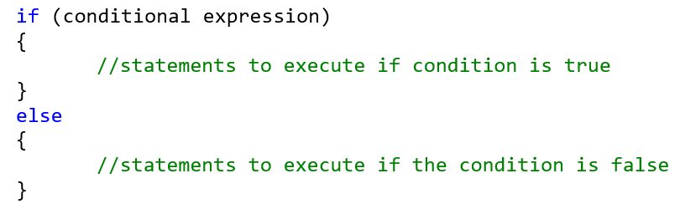

Slide 4
Flow chart shapes
Start /end
Input/ output
process
decision

Slide 5
Examples
Ask and get height
Height > 76
YES
Print tall message
Print athletic message
NO
Continue with the rest of the program

Slide 6
Examples
Ask and get height
Height > 76
YES
Print tall message
NO
Print athletic message
Continue with the rest of the program

Slide 7
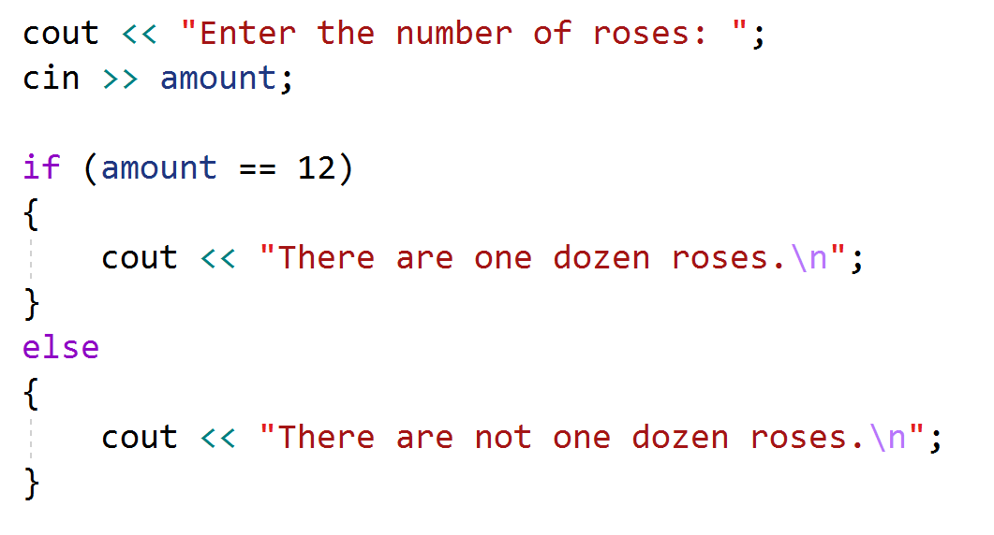
Examples
Ask and get amount
Amount = = 12
YES
Print dozen roses message
NO
Print not one dozen message
Continue with the rest of the program

Slide 8
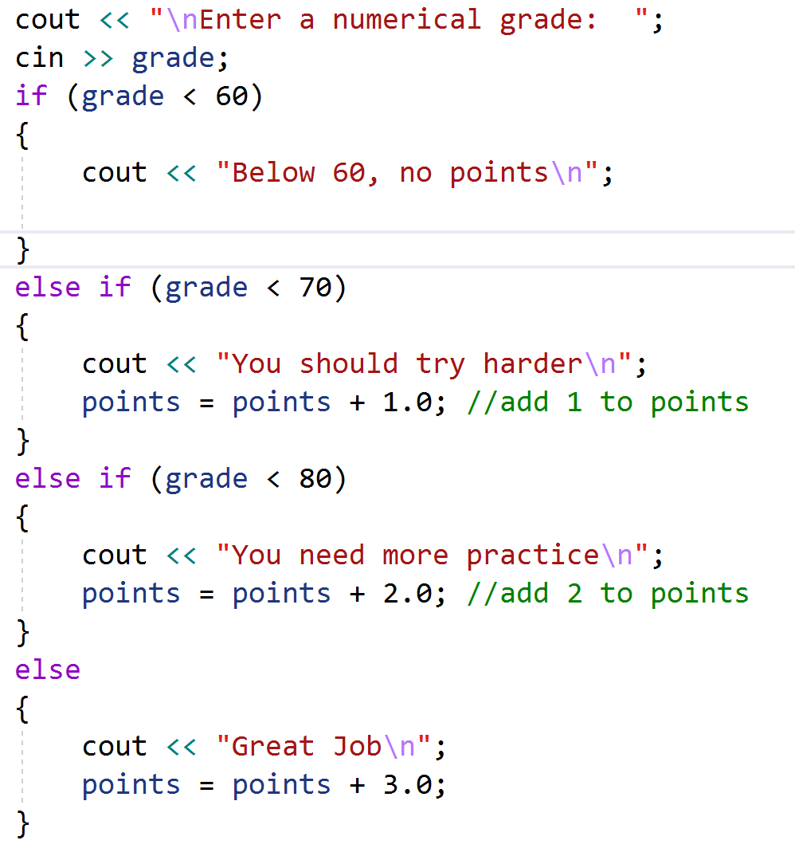
Ask and get grade
grade < 60
YES
Print message
NO
grade < 70
YES
Print try harder message
NO
Add 1 to points
grade < 80
YES
Print message
NO
Print great job message
Add 2 to points
Add 3 to points
Continue with the rest of the program

Slide 9
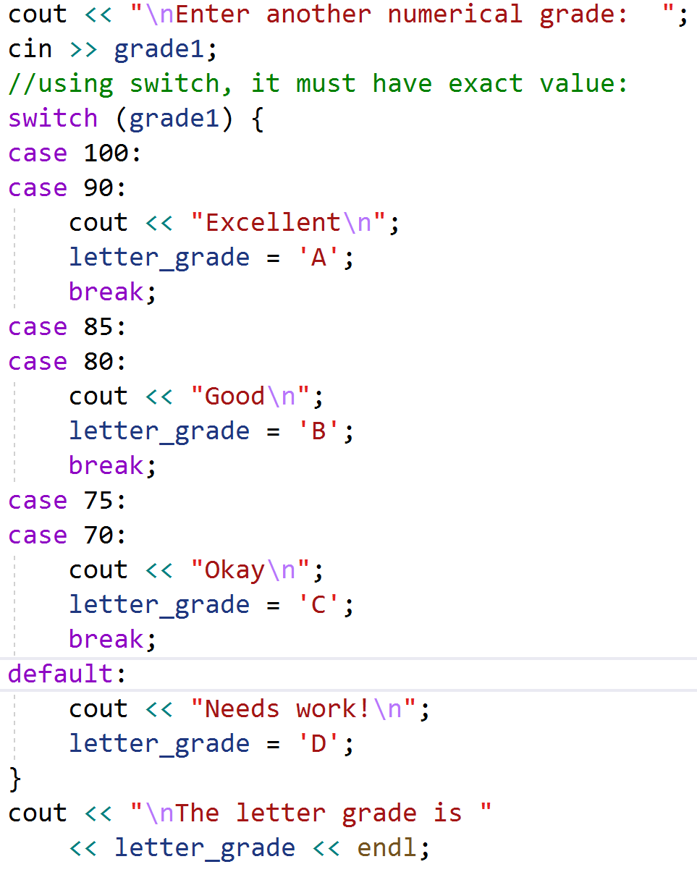
Ask and get grade
grade 100 or 90
YES
Print excellent
NO
Assign ‘A’
grade 85 or 80
YES
Print good
NO
Assign ‘B’
grade 75 or 70
YES
Print okay
NO
Assign ‘C’
Print needs work
Continue with the rest of the program

